Slide 1
Python programming
unit 7 – practice with more game programming

Slide 2
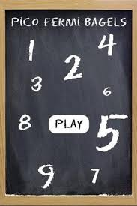
pico fermi bagels game
The computer will have a secret 3-digit number, you will try to guess it. Each digit is different.
Each time you guess, if there is one digit number you guess right and also the position is right, computer will prompt ‘Fermi’.
If you guess the number right but position is wrong, computer will prompt ‘Pico’
If you guess is wrong then computer will prompt ‘Bagel’
Example: computer has ‘372’. You guess ‘702’. Computer will give you prompt ‘Fermi Pico Bagel’. You guess ‘125’, computer will give you ‘Pico Bagel Bagel’

Slide 3
pico fermi bagels game – flow chart
START
Generate secret number
User guess
Guess same as secret?
N
Y
Add score
Play again?
Y
N
END

Slide 4

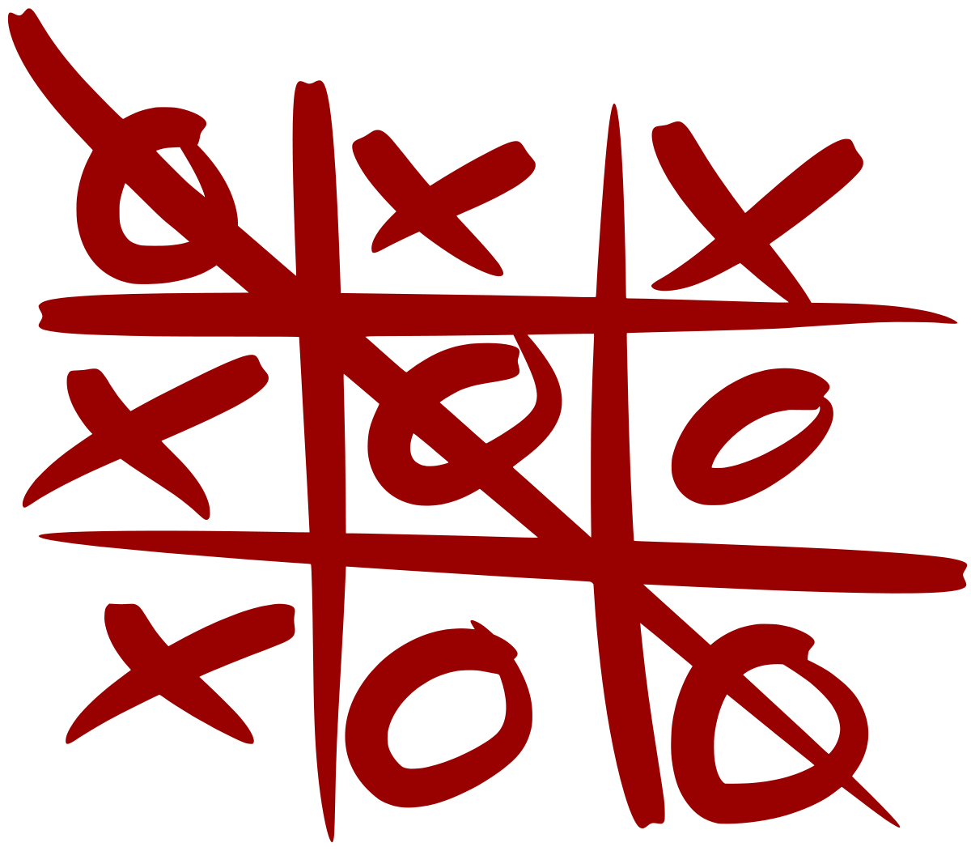
Tic tac toe game
In a 3x3 board, player each takes turn. When one player finish one line or one column or diagonal, then the player win.
If board all finish and no player win, the game is a draw.
Unit test for each function, write test code to drive the test of all the functionality of the specific function.
Frequent test is an important part of programming.

Slide 5
Tic tac toe game – use case diagram
Tic Tac Toe Game
Start Game
Initialize game board
Decide who take ‘X’, who take ‘O’
Make one move
Player
Decide who make first move
Computer make one move
Check win or not
Exit game
Play again

Slide 6
Tic tac toe game – use case description
Use Case | Start Game
Actor | Player
Pre condition | None
Post condition | User and Computer start play
Primary path | Ask User be ‘X’ or ‘O’ Initialize empty game board Randomly decide who make the first move

Slide 7
Tic tac toe game – use case description
Use Case | User makes one move
Actor | Player
Pre condition | Game started
Post condition | User win, or game end draw, or computer move
Primary path | Ask user for move coordinates Check if move is valid Add the move to game board Check if user win or game end in draw Continue to computer makes move
Use Case | Computer move
Actor
Pre condition | Game started
Post condition | Computer win, or game end draw, or user to move
Primary path | AI select move** Add the move to game board Check if computer win or game end in draw Continue to user makes move
**Computer next move algorithms:
1/ if one move can win, take that
2/ if user one move can win, take that to block
3/ take a random available move
3/ take centre space if free
4/ take one corner space if free
5/ take side space if have
6/ no space, game end in draw

Slide 8
Tic tac toe game – use case description
Use Case | Play again
Actor | Player
Pre condition | One round game finished
Post condition | Start game again, or exit game
Primary path | Print Previous round result Ask user if want continue again If no exit game If yes restart game

Slide 9
Tic tac toe game – class diagram
Player
player
__init__ next_move
GameController
game_board user computer
__init__ replay_game start_game exit_game
GameBoard
moves
__init__ render_board check_space_free add_one_move check_win check_full
UserPlayer
player
__init__ next_move
ComputerPlayer
player
__init__ next_move find_onemove_win find_onemove_lose find_center_move find_corner_move find_side_move

Slide 10
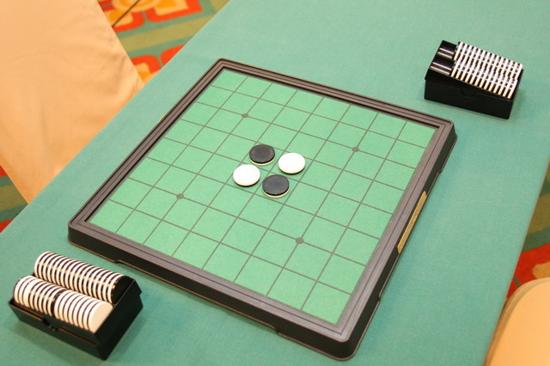
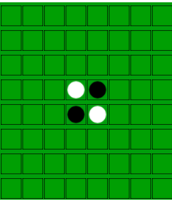
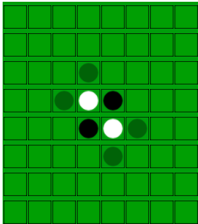
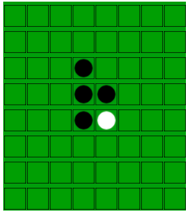
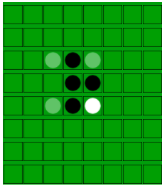
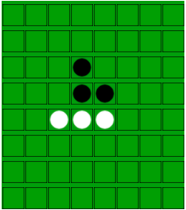
Reversi game
In a 8X8 board, 2 player take turn to place disks, with their assigned color.
If after placed one disk, the opponent’s are in straight line (column, row, or diagonal) and are bounded by your disks at both ends, those are reversed to be your disks.
Each time the player put his disk, it must be adjacent to the opponent’s disk and thus turn some of opponent’s disk to himself. If cannot find any this kind cell on board, the player must skip his move and give to his opponent.
When both cannot move the game end.

Slide 11
Reversi game – use case diagram
Reversi Game
Start Game
Initialize game board
Decide who take ‘X’, who take ‘O’
Make one move
Player
‘X’ make first move
Computer make one move
Check move, update score
Exit game
Play again
Ask hints

Slide 12
Reversi game – use case description
Use Case | Start Game
Actor | Player
Pre condition | None
Post condition | User and Computer start play
Primary path | Ask User be ‘X’ or ‘O’ Initialize game board Start play, ‘X’ makes first move

Slide 13
Reversi game – use case description
Use Case | User makes one move
Actor | Player
Pre condition | Game started
Post condition | Game end, or user quit, or user ask for hits, or computer move
Primary path | Check if user has valid move. If no inform user skip this turn Ask for user command (move coordinates, or quit, or hints) Check if move is valid Add the move to game board Check if game end Continue to computer makes move
Use Case | Computer move
Actor
Pre condition | Game started
Post condition | Game end, or user move
Primary path | Check if has valid move. If no inform user computer skip AI select next move** Add the move to game board Check if game end Continue to user makes move
**Computer next move algorithms:
1/ get all valid moves
2/ if has corner then take one of corner
3/ if has edge, take one of edge
4/ take the one flips the most of player’s

Slide 14
Reversi game – use case description
Use Case | User ask for hints
Actor | Player
Pre condition | Game started, user turn to move
Post condition | user ask hint with h
Primary path | When user turn to move, user enter h Show valid moves with ‘-’ After user choose a move remove all cells marked with hint ‘-’

Slide 15
Reversi game – use case description
Use Case | User want quit
Actor | Player
Pre condition | Game started, user turn to move
Post condition | user quit
Primary path | When user turn to move, user enter q Exit game

Slide 16
Reversi game – use case description
Use Case | User want play again
Actor | Player
Pre condition | Game finished.
Post condition | user play again
Primary path | When game finished, user enter ‘y’ to player again Restart game

Slide 17
Class diagram
Player
player
__init__ next_move
GameController
game_board user computer
__init__ replay_game start_game exit_game
GameBoard
moves
__init__ render_board get_hints add_one_move show_hints reset_moves
UserPlayer
player
__init__ next_move
ComputerPlayer
player
__init__ next_move find_corner_move find_side_move find_mostflip_move

Slide 18
Sonar game
Find treasure in a sea area.
One sonar can detect the x distance <=9 and y distance <=9 square area.
If 3 treasure all detected game end
If all 16 Sonar detector used game end

Slide 19
Sonar game – use case diagram
SONAR Game
Start Game
Initialize game board
Initialize treasure chest
Drop one sonar
Player
All sonar finished
Present detect result
Exit game

Slide 20
sonar game – use case description
Use Case | Start Game
Actor | Player
Pre condition | None
Post condition | User ready to play
Primary path | Initialize the game field Initialize 3 treasure chest

Slide 21
Reversi game – use case description
Use Case | User put one sonar
Actor | Player
Pre condition | Game started
Post condition | user quit, game end, show detect result
Primary path | If user want quit, game exit If all 3 treasure chests found, game finish Show the sonar detect result
Use Case | User put last sonar
Actor | Player
Pre condition | Game started
Post condition | detect result, or Game end, or user quit,
Primary path | If user want quit, game exit If all 3 treasure chests found, game end Show the sonar detect result, game end

Slide 22
Class diagram
GameController
game_board user
__init__ start_game exit_game
GameBoard
moves
__init__ render_board add_one_detect show_result reset_game
UserPlayer
player
__init__ put_next put_last

Slide 23

Caesar cipher
One of the important thing computer do is to encrypt and decrypt message for security communication.
Caesar Cipher is one of the oldest ways to send message securely. This method shifts the letter in the words, and send all the words shifted.
When the receiver received, then shift all the letters back, can get the correct message.
Other people who get the message, if he/she do not know how it is shifted, they will not able to recognize the message.
How many letters shifted in alphabet table is the secret key.

Slide 24
Caesar cipher – flow chart
START
Ask to do encrypt, or decrypt, or brutal-force?
Encrypt
Brute-force
Decrypt
secret key
secret key
Ask for plaintext
Ask for ciphertext
Ask for ciphertext
Output ciphertext
Output plaintext
Output all 25 possible plain text
Y
Do again?
N
END

Slide 25
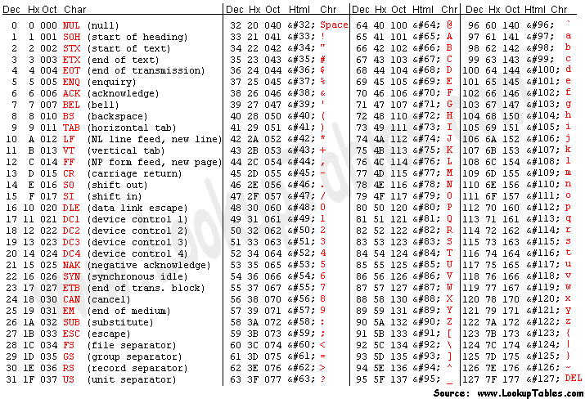
0x61
97
0x41
65
0x5a
90
0x7a
122

